Slide 1
Checkers for Android
Bijay Regmi
Dylan Detillier
Brandon Phillips
Christopher Schilling

Slide 2
Team Member Tasks
Bijay Regmi - Backend & Logic, Documentation, & Testing
Dylan Detillier - UI Development, Documentation & Testing
Christopher Schilling - Testing/CI, Documentation, UI Development
Brandon Phillips - Testing, UI Development, Logic, AI

Slide 3
Tools Utilized
Android Studio - Used for development and implementation of our code for the app
GitHub - File management between users and version control
Discord - Channel for project discussion and general information and task assignment
Google Docs - Real-time sharing of project documents
Travis CI - Continuous integration service used for testing and controlling our code
Visual Paradigm - Used to create & build various diagrams

Slide 4
Highlighted Features of the Game
Player vs. Computer Mode (1 player)
Player vs. Player Mode (2 players)
Save/Load Functionality
Supports Multiple Screen Sizes
Automatic Screen Resizing - Screen size scales depending on device's screen size
Supports Screen Rotation
Portrait Orientation to Landscape Orientation, vice versa

Slide 5
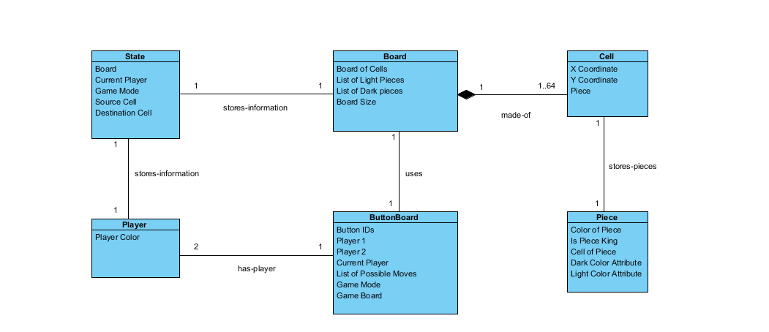
Conceptual Class Diagram

Slide 6
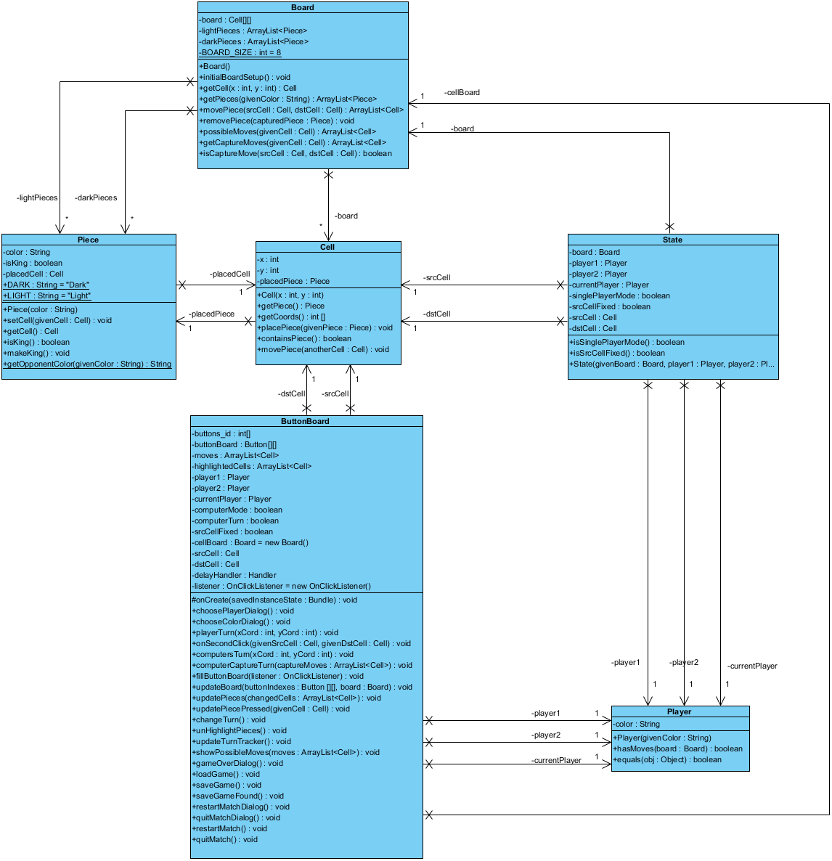
Class Diagram
Diagram of the interactions of our classes:
Cell
Board
ButtonBoard (UI)
Piece
Player
State

Slide 7
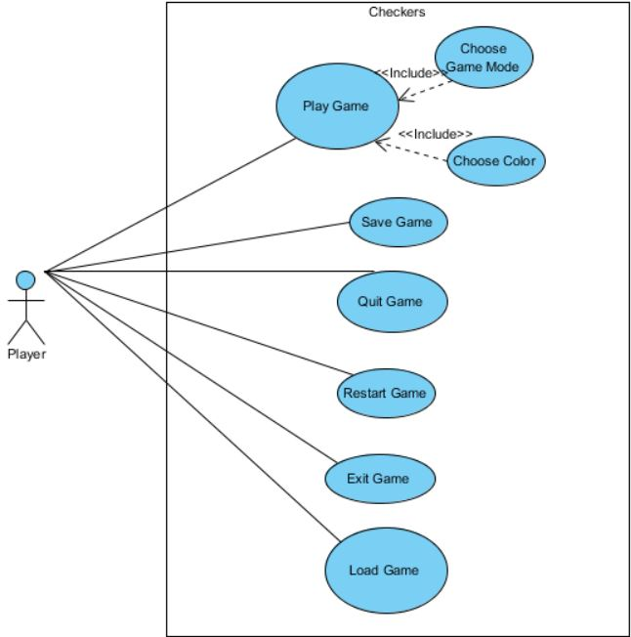
Use Case
Most common Use Case for playing the game
Includes features such as:
Playing Game
Choosing Game Mode and Color
Saving
Loading
Exit Game

Slide 8
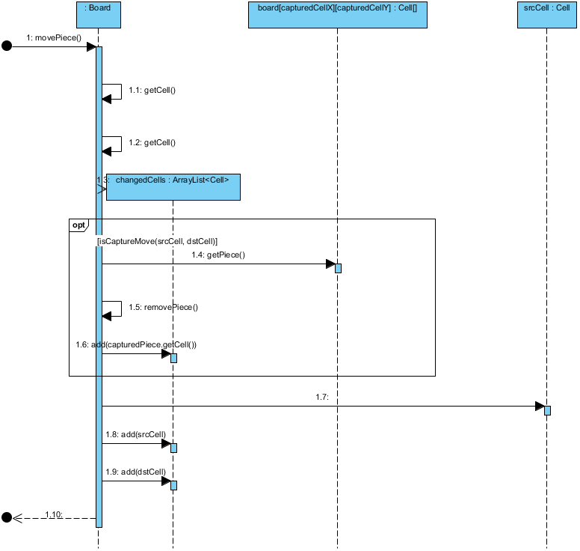
System Sequence
System sequence for our Move Piece method.
movePiece(xSrc, ySrc, xDst, yDst)
Steps through:
Method invocation
The steps of execution
What the method call returns

Slide 9
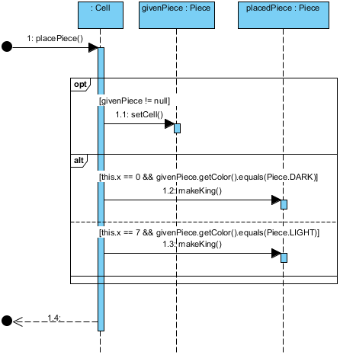
System Sequence
System sequence for our Place Piece method.
placePiece(Piece givenPiece)
Used when setting up the game board.

Slide 10
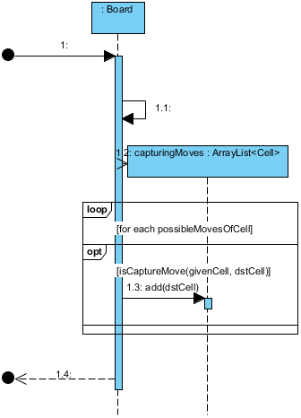
System Sequence
System sequence for our Get Capture Moves method
getCaptureMoves(Cell givenCell)
Gets the captures moves of a given cell on the board.

Slide 11
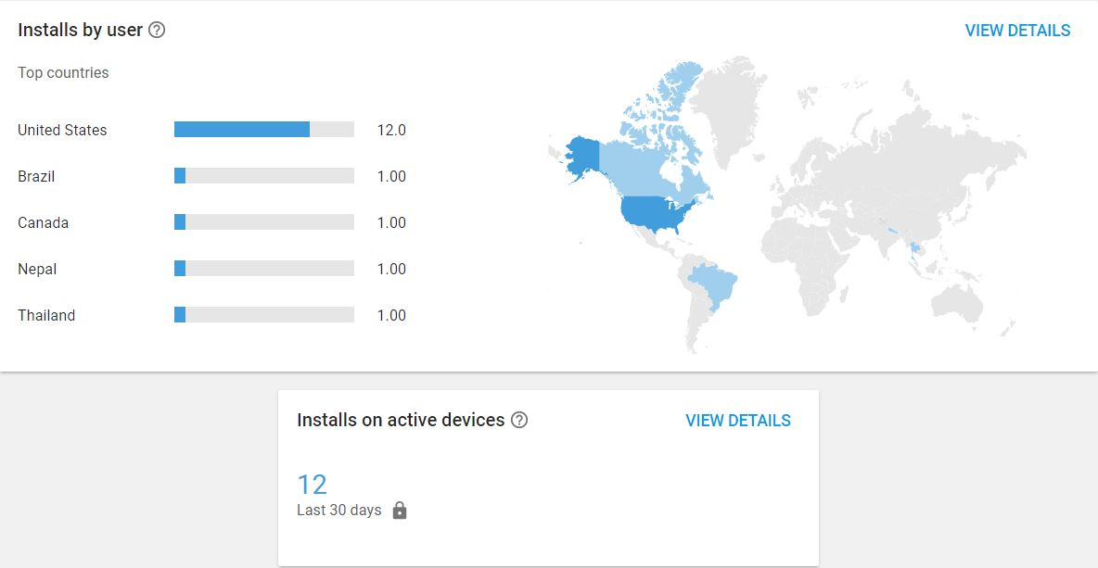
Achievements

